Slide 1

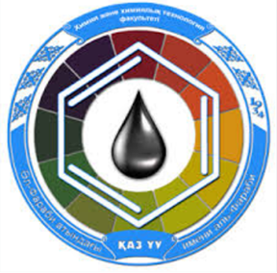
Reaction mechanisms in coordination compounds.
Al-Farabi Kazakh National University
Faculty of Chemistry and Chemical technology
Department of General and Inorganic Chemistry
PhD Bakhadur Askar

Slide 2
Reactivity in coordination chemistry
Reactions of coordination compounds are central to understanding metal-ligand dynamics and catalytic cycles in both inorganic and bioinorganic chemistry.
Unlike simple ionic reactions, these processes involve complex reorganizations of the coordination sphere around the central metal ion.
Main Types of Reactions:
Substitution Reactions — exchange of ligands in the inner coordination sphere.
Electron Transfer Reactions — oxidation-reduction between metal centers or between metal and ligands.
Isomerization and Rearrangement — internal reorganization without a change in composition.
Such mechanisms determine the stability, reactivity, and function of coordination complexes in catalysis, biological systems, and materials chemistry.

Slide 3



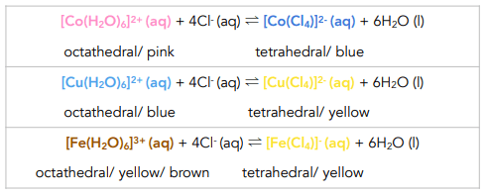

Ligand substitution reactions
Ligand substitution is the most common process in coordination chemistry, where one ligand replaces another around the same metal ion.
$$\left[ML_{n}\right]+L^{′}→\left[ML_{n}^{′}\right]+L$$
These reactions are classified according to their mechanistic pathways:
Dissociative (D) mechanism:
A ligand departs first, creating a lower coordination intermediate before a new ligand binds.
Common for high-spin complexes and large, labile metals , e.G., $\left[Co\left(H_{2}O{\left.)\right.}_{6}{\left.]\right.}^{2+}\right.\right.$
Associative (a) mechanism:
the incoming ligand coordinates first, forming a higher coordination transition state before one ligand leaves.
Typical of low-spin d⁸ metals (e.G., Pt(ii), pd(ii)).
Interchange (i) mechanism:
both bond breaking and forming occur simultaneously, without fully isolating intermediates.
This is the most common case in aqueous metal complexes.

Slide 4
Kinetic and thermodynamic control
The reactivity of a coordination compound can be governed by kinetic lability or thermodynamic stability.
Kinetic Factors:
  Rate of ligand substitution depends on metal oxidation state, electronic configuration, and ligand type.
  Labile complexes (e.g., first-row transition metals with high-spin configurations) undergo rapid substitution.
  Inert complexes (e.g., low-spin d⁶ ions like Co³⁺ or Cr³⁺) react slowly.
Thermodynamic Factors:
  Determine the equilibrium composition and stability of products.
  Even an inert complex may be thermodynamically unstable and vice versa.
Thus, kinetic and thermodynamic aspects together define whether a coordination reaction will occur and how fast it proceeds.

Slide 5

Electron transfer reactions
Electron transfer plays a vital role in redox processes involving coordination compounds.
1. Inner-Sphere Mechanism:
A ligand acts as a bridge between two metal centers, temporarily coordinating both and allowing direct electron transfer.
Example:
$$\left[Co\left(NH_{3}{\left.)\right.}_{5}Cl{\left.]\right.}^{2+}+\left[Cr\left(H_{2}O{\left.)\right.}_{6}{\left.]\right.}^{2+}→\left[Co\left(NH_{3}{\left.)\right.}_{5}\left(H_{2}O\right){\left.]\right.}^{3+}+\left[Cr\left(H_{2}O{\left.)\right.}_{5}Cl{\left.]\right.}^{2+}\right.\right.\right.\right.\right.\right.\right.\right.$$
The chloride ion serves as the bridging ligand.
2. Outer-Sphere Mechanism:
Electron transfer occurs without direct ligand exchange, through orbital overlap across the solvent barrier.
This is typical for complexes with inert coordination spheres.
These mechanisms are central to biochemical electron transport and electrocatalysis.

Slide 6

Isomerization and rearrangement reactions
In some coordination compounds, the connectivity of ligands does not change, but their spatial arrangement or bonding mode does.
Types of Rearrangements:
Linkage Isomerization:
In ambidentate ligands (e.g., NO₂⁻, SCN⁻), the donor atom changes from nitrogen to oxygen or sulfur.
$$\left[Co\left(NH_{3}{\left.)\right.}_{5}NO_{2}{\left.]\right.}^{2+}⇌\left[Co\left(NH_{3}{\left.)\right.}_{5}ONO{\left.]\right.}^{2+}\right.\right.\right.\right.$$
Geometrical Isomerization:
Ligands exchange positions (cis ↔ trans), affecting properties like color and reactivity.
Intramolecular Rearrangements:
In organometallic complexes, ligands migrate from metal to adjacent atoms or vice versa (e.g., hydride shifts).
Such rearrangements influence spectroscopic signatures, reactivity, and biological function of metal complexes.

Slide 7
Factors influencing reaction rates
Metal Ion Characteristics:
Oxidation state, ionic radius, and d-electron configuration. Higher charge often increases inertness.
Nature of Ligands:
Electron-donating ligands stabilize intermediates, while π-acceptors can promote substitution or redox reactions.
Solvent Effects:
Protic vs. aprotic solvents modify activation energies by stabilizing charged species.
Steric Effects:
Bulky ligands hinder associative pathways, favoring dissociative mechanisms.
Temperature and Ionic Strength:
Affect activation barriers and diffusion-controlled processes.

Slide 8
Summary
Coordination reactions include substitution, electron transfer, and isomerization processes.
Mechanistic pathways — associative, dissociative, or interchange — depend on the metal center and ligands.
Kinetic lability and thermodynamic stability determine reaction feasibility and speed.
Inner- and outer-sphere electron transfers are vital for redox and catalytic systems.
Ligand rearrangements lead to isomerism and structural diversity in complexes.
Reaction rates are governed by electronic, steric, and environmental factors.
Mechanistic insights underpin advances in industrial catalysis, bioinorganic chemistry, and molecular design.

Slide 9
Thank you for attention!

